Slide 1
Lecture 18: Anatomy of NN

Slide 2
Outline
Anatomy of a NN
Design choices
Activation function
Loss function
Output units
Architecture

Slide 3
Outline
Anatomy of a NN
Design choices
Activation function
Loss function
Output units
Architecture

Slide 4
Anatomy of artificial neural network (ANN)
neuron
node
input
output
X
Y

Slide 5
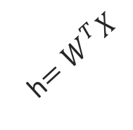
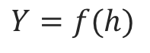
Anatomy of artificial neural network (ANN)
neuron
node
input
output
Affine transformation
$$Y=f(h)$$
Activation
X
Y
h$=W^{T}X$
We will talk later about the choice of activation function. So far we have only talked about sigmoid as an activation function but there are other choices.

Slide 6

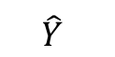
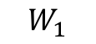
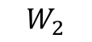
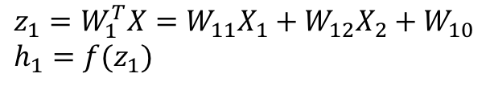
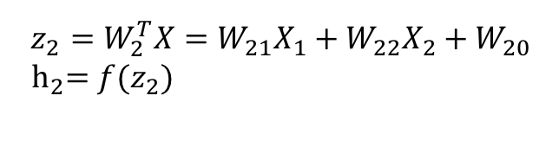
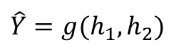
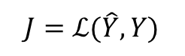
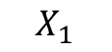
Anatomy of artificial neural network (ANN)
Input layer
hidden layer
output layer
$$z_{1}=W_{1}^{T}X=W_{11}X_{1}+W_{12}X_{2}+W_{10} \\ h_{1}=f(z_{1})$$
$$X_{1}$$
$$W_{1}$$
$$\hat{Y}$$
$$\hat{Y}=g(h_{1},h_{2})$$
$$J=ℒ(\hat{Y},Y)$$
Output function
Loss function
$$X_{2}$$
$$W_{2}$$
$$z_{2}=W_{2}^{T}X=W_{21}X_{1}+W_{22}X_{2}+W_{20}$$
$${ h}_{2}=f(z_{2})$$
We will talk later about the choice of the output layer and the loss function. So far we consider sigmoid as the output and log-bernouli.

Slide 7
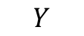
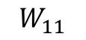
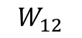
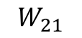
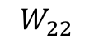
Anatomy of artificial neural network (ANN)
Input layer
hidden layer 1
hidden layer 2
output layer
$$X_{1}$$
$$W_{11}$$
$$W_{21}$$
$$Y$$
$$X_{2}$$
$$W_{12}$$
$$W_{22}$$

Slide 8
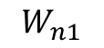
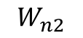
Anatomy of artificial neural network (ANN)
Input layer
hidden layer 1
hidden layer n
output layer
$$X_{1}$$
$$W_{11}$$
…
$$W_{n1}$$
$$Y$$
$$X_{2}$$
$$W_{12}$$
…
$$W_{n2}$$
We will talk later about the choice of the number of layers.

Slide 9
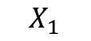
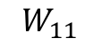
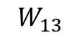
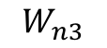
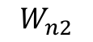
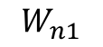
Anatomy of artificial neural network (ANN)
Input layer
hidden layer 1, 3 nodes
hidden layer n
3 nodes
output layer
$$W_{n1}$$
$$W_{11}$$
$$X_{1}$$
$$W_{12}$$
…
$$W_{n2}$$
$$Y$$
$$X_{2}$$
$$W_{13}$$
$$W_{n3}$$

Slide 10
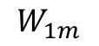
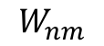
Anatomy of artificial neural network (ANN)
Input layer
hidden layer 1,
hidden layer n
output layer
m nodes
$$W_{n1}$$
$$W_{11}$$
$$X_{1}$$
m nodes
…
…
$$Y$$
$$X_{2}$$
$$W_{1m}$$
$$W_{nm}$$
We will talk later about the choice of the number of nodes.

Slide 11
Anatomy of artificial neural network (ANN)
Input layer
hidden layer 1,
hidden layer n
output layer
m nodes
$$W_{n1}$$
$$W_{11}$$
$$X_{1}$$
m nodes
Number of inputs d
…
…
$$Y$$
$$X_{2}$$
$$W_{1m}$$
$$W_{nm}$$
Number of inputs is specified by the data

Slide 12
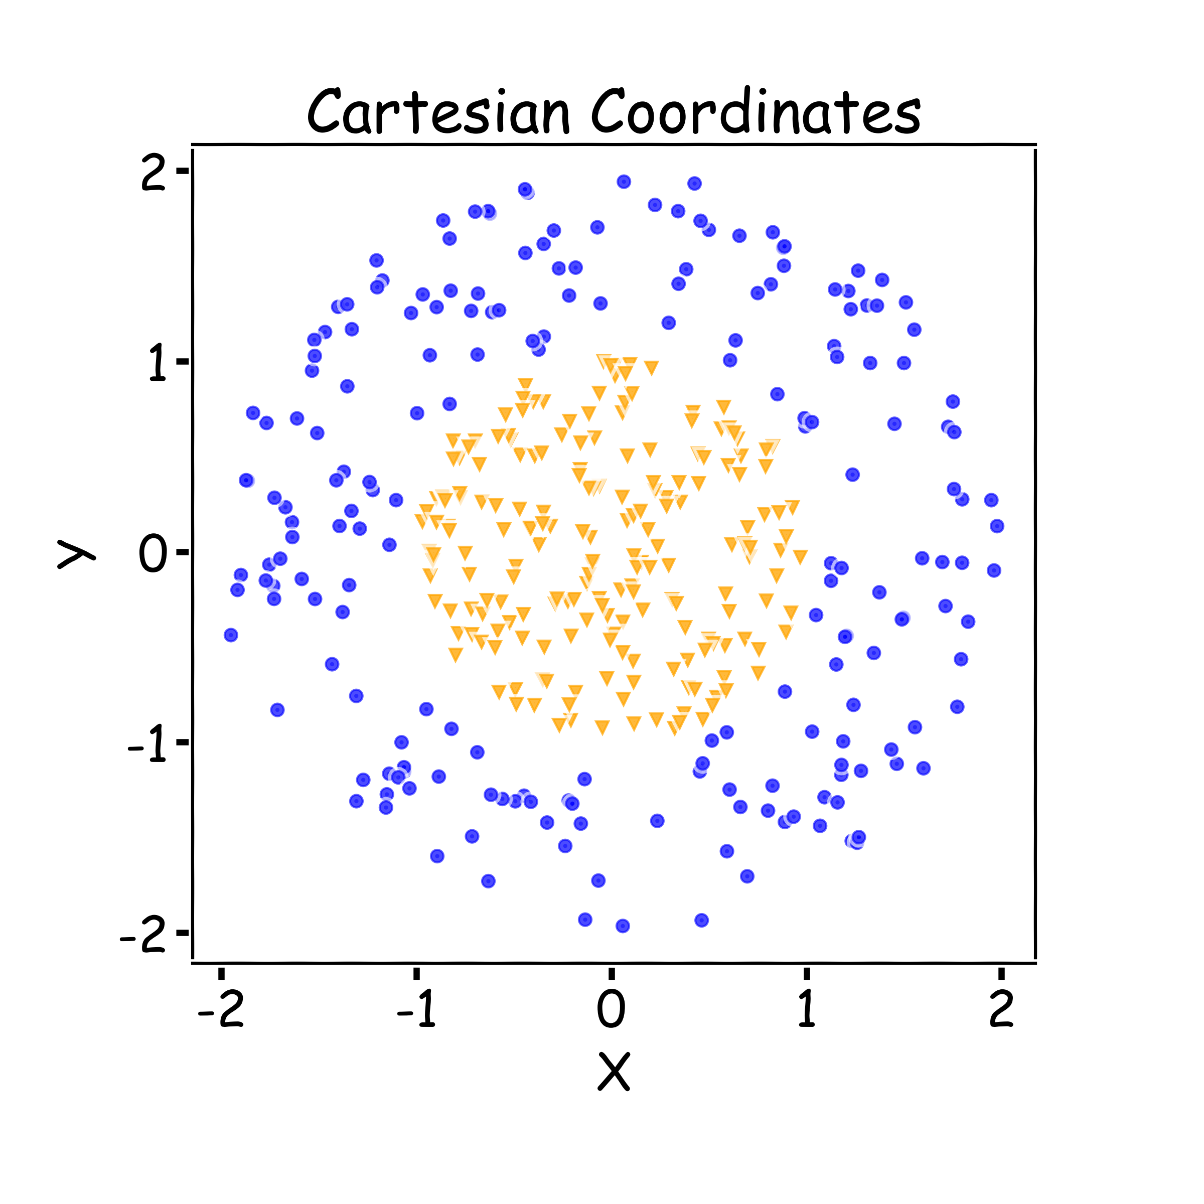
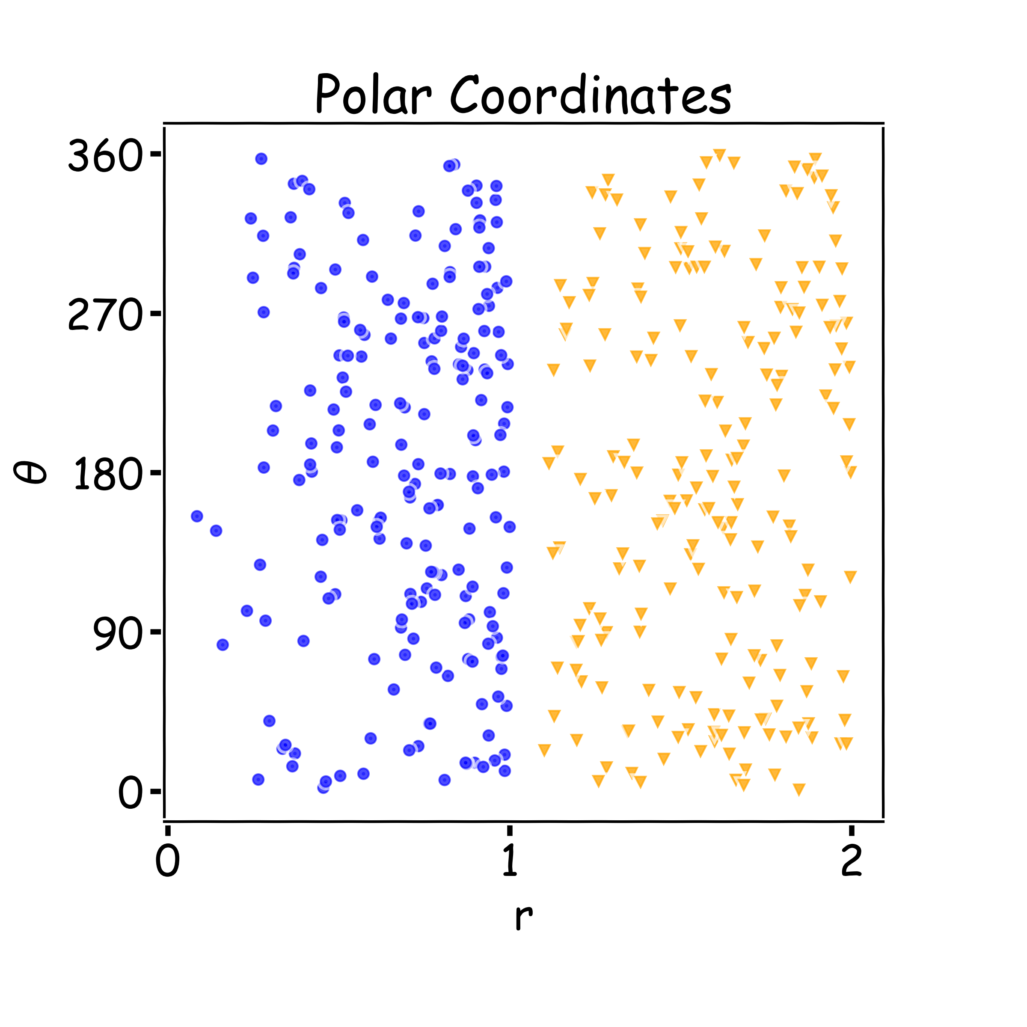
Why layers? Representation
Representation Matters

Slide 13
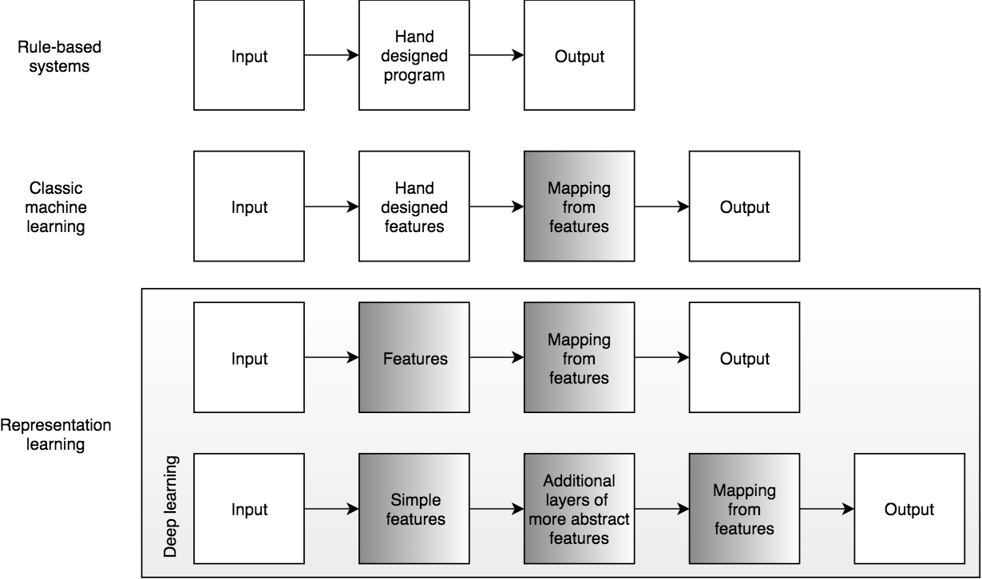
Learning Multiple Components

Slide 14
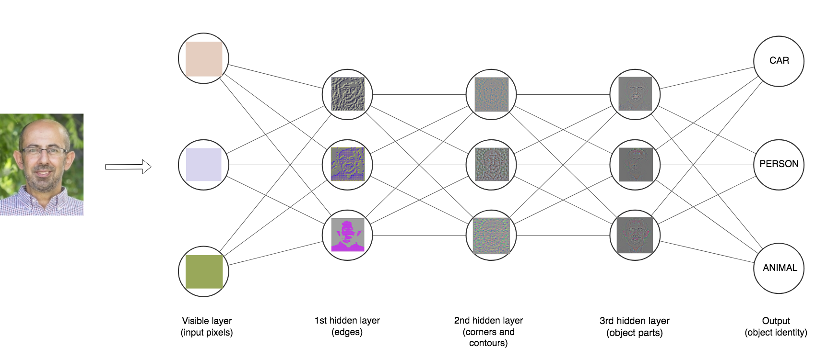

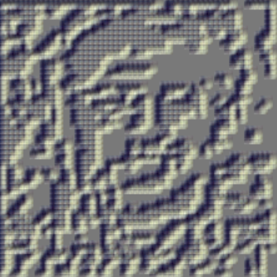
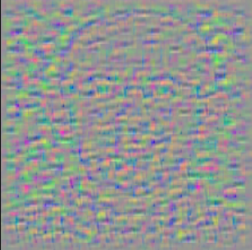


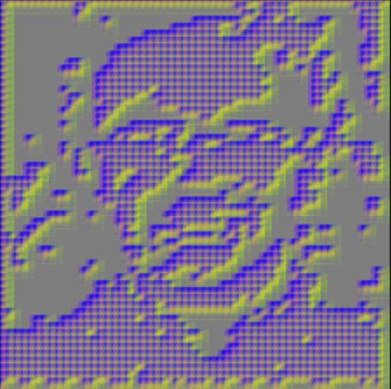
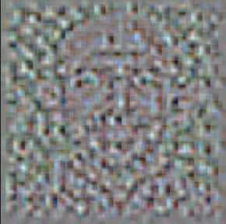
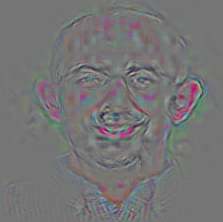
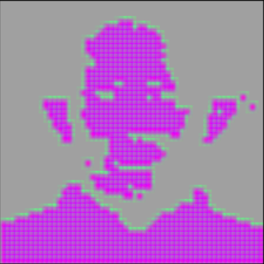
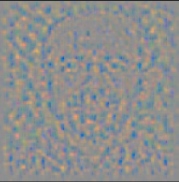


Depth = Repeated Compositions

Slide 15
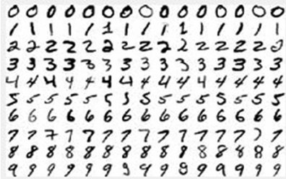
Neural Networks
Hand-written digit recognition: MNIST data

Slide 16
Outline
Anatomy of a NN
Design choices
Activation function
Loss function
Output units
Architecture

Slide 17
Outline
Anatomy of a NN
Design choices
Activation function
Loss function
Output units
Architecture

Slide 18
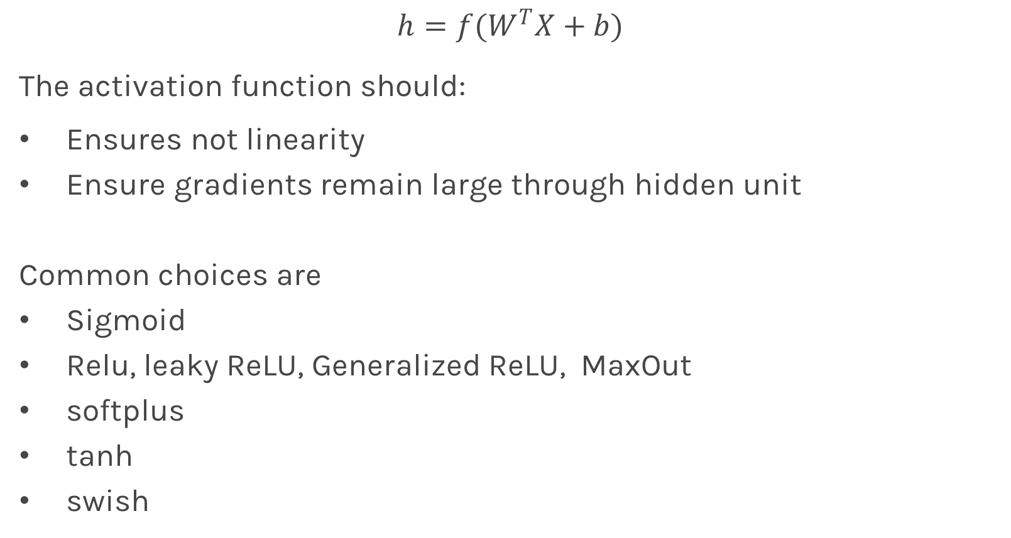
Activation function
$$h=f(W^{T}X+b)$$
The activation function should:
Ensures not linearity
Ensure gradients remain large through hidden unit
Common choices are
Sigmoid
Relu, leaky ReLU, Generalized ReLU, MaxOut
softplus
tanh
swish

Slide 19
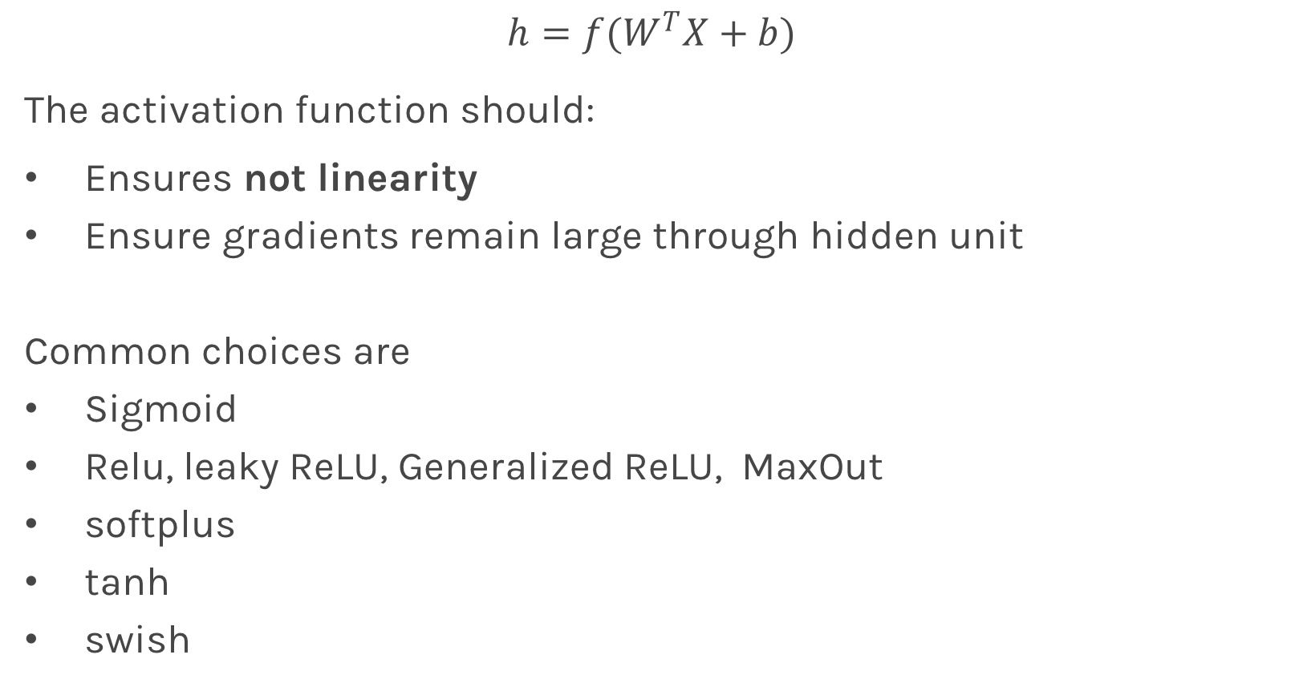
Activation function
$$h=f(W^{T}X+b)$$
The activation function should:
Ensures not linearity
Ensure gradients remain large through hidden unit
Common choices are
Sigmoid
Relu, leaky ReLU, Generalized ReLU, MaxOut
softplus
tanh
swish

Slide 20

Beyond Linear Models
Linear models:
Can be fit efficiently (via convex optimization)
Limited model capacity
Alternative:
Where $φ$ is a non-linear transform

Slide 21
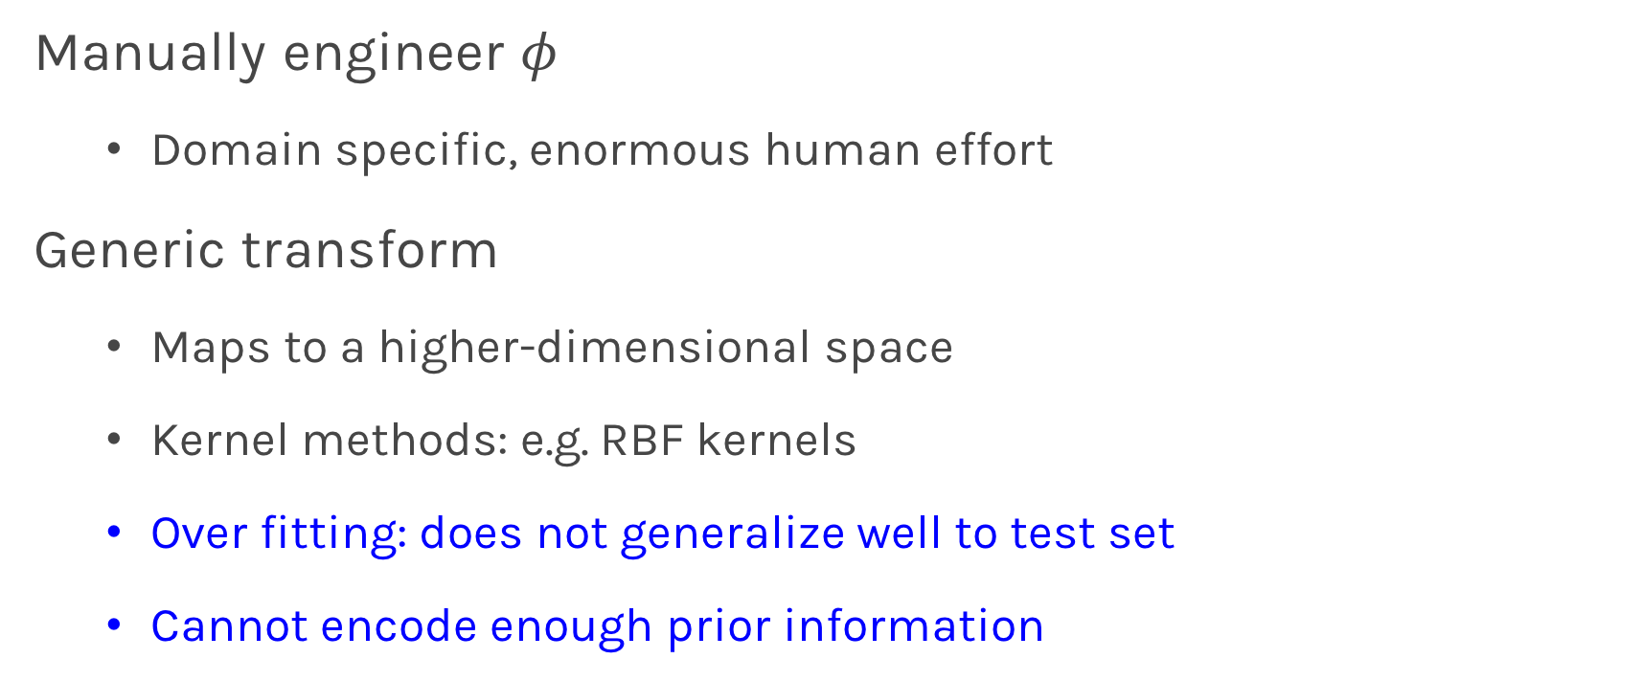
Traditional ML
Manually engineer $φ$
Domain specific, enormous human effort
Generic transform
Maps to a higher-dimensional space
Kernel methods: e.g. RBF kernels
Over fitting: does not generalize well to test set
Cannot encode enough prior information

Slide 22
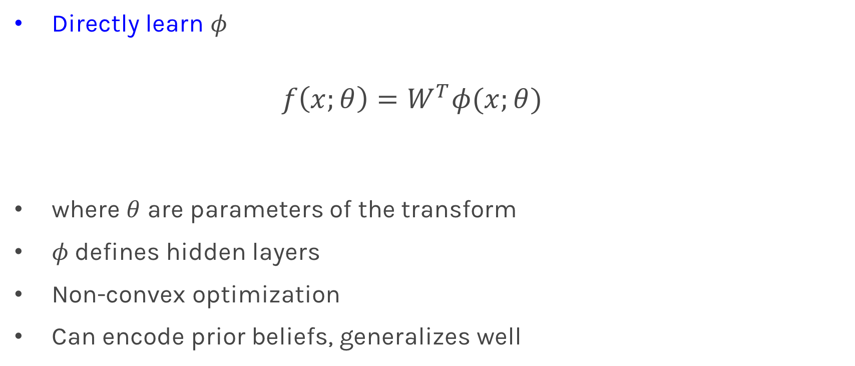
Deep Learning
Directly learn $φ$
$$f\left(x;θ\right)=W^{T}φ(x;θ)$$
where $θ$ are parameters of the transform
$φ$defines hidden layers
Non-convex optimization
Can encode prior beliefs, generalizes well

Slide 23
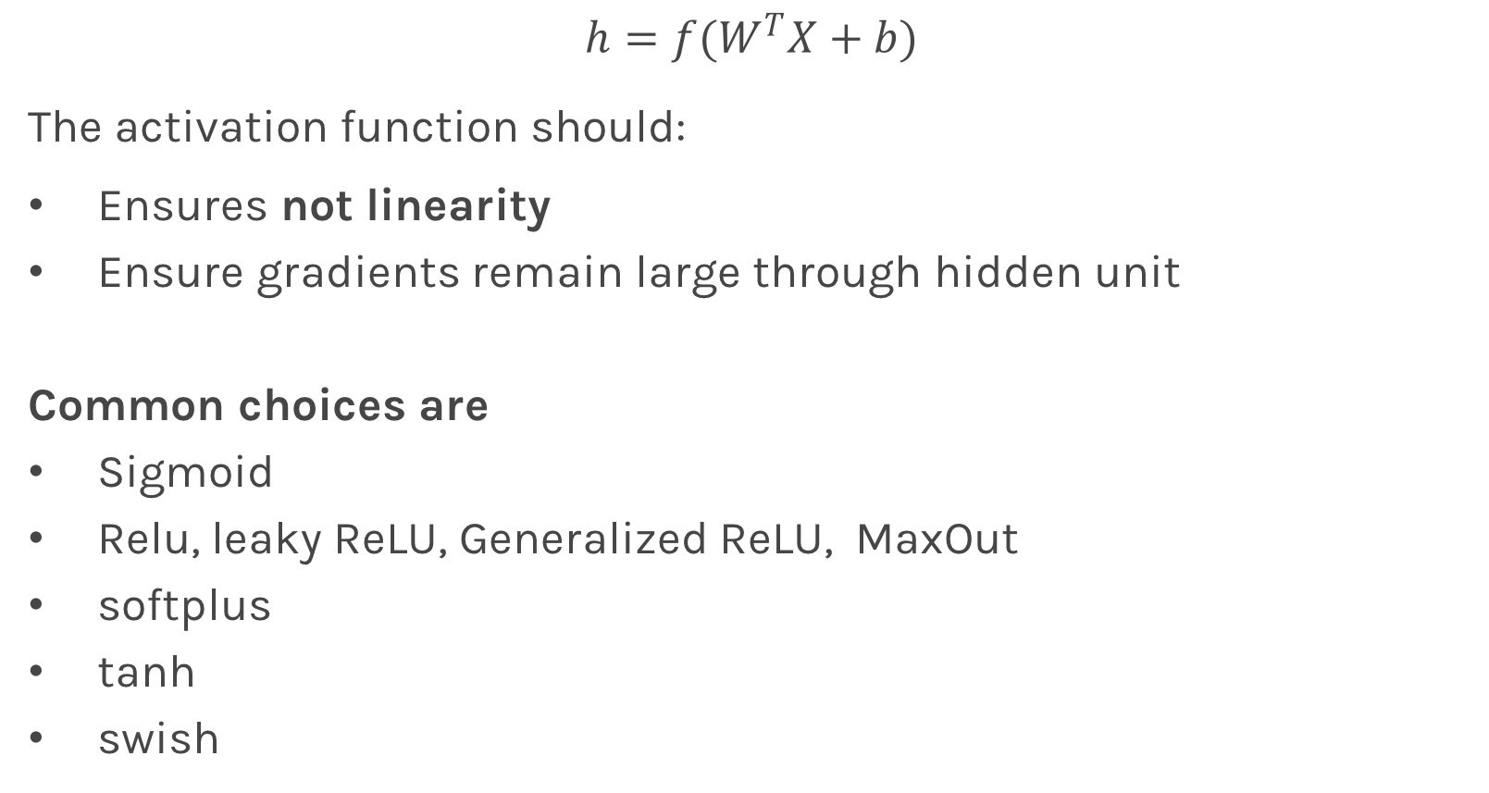
Activation function
$$h=f(W^{T}X+b)$$
The activation function should:
Ensures not linearity
Ensure gradients remain large through hidden unit
Common choices are
Sigmoid
Relu, leaky ReLU, Generalized ReLU, MaxOut
softplus
tanh
swish

Slide 24
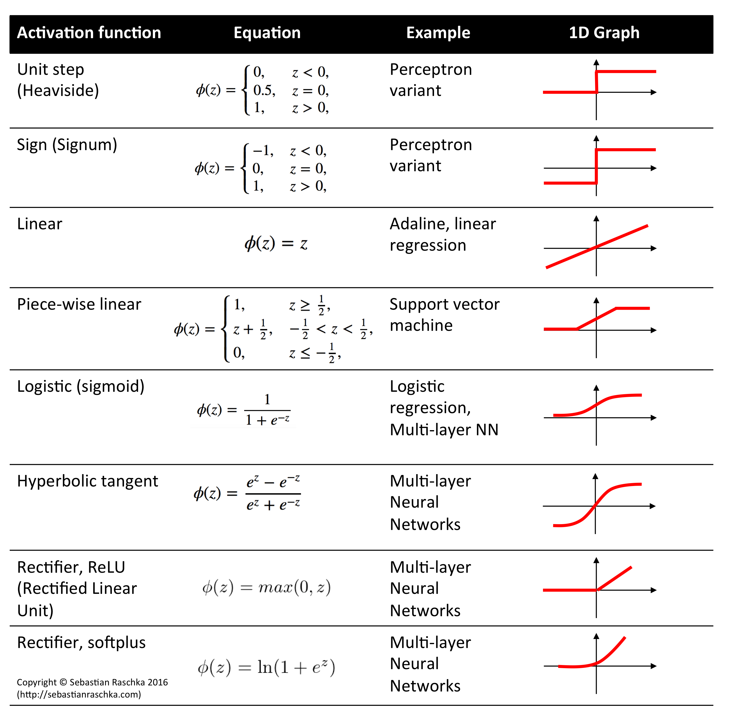

Slide 25
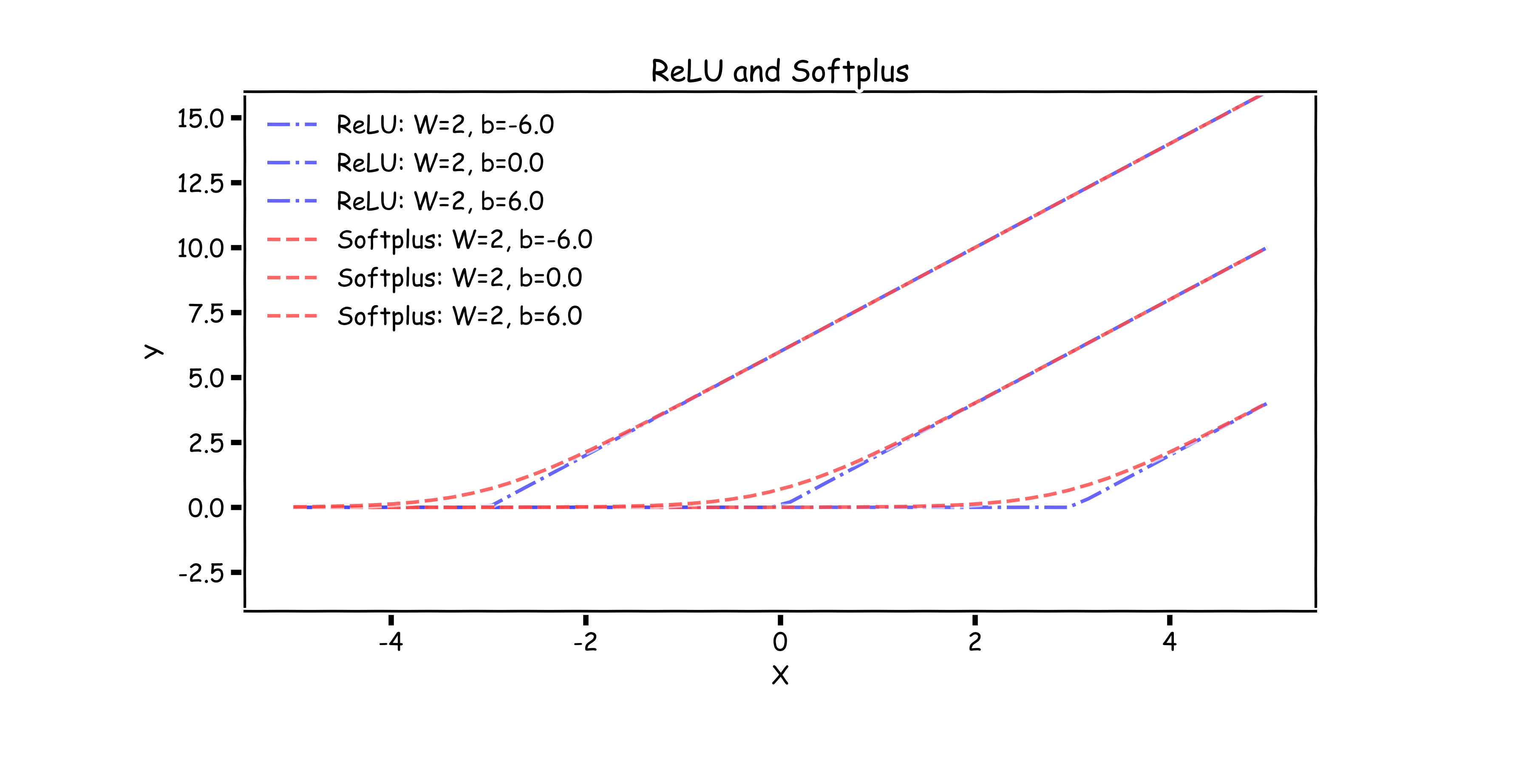
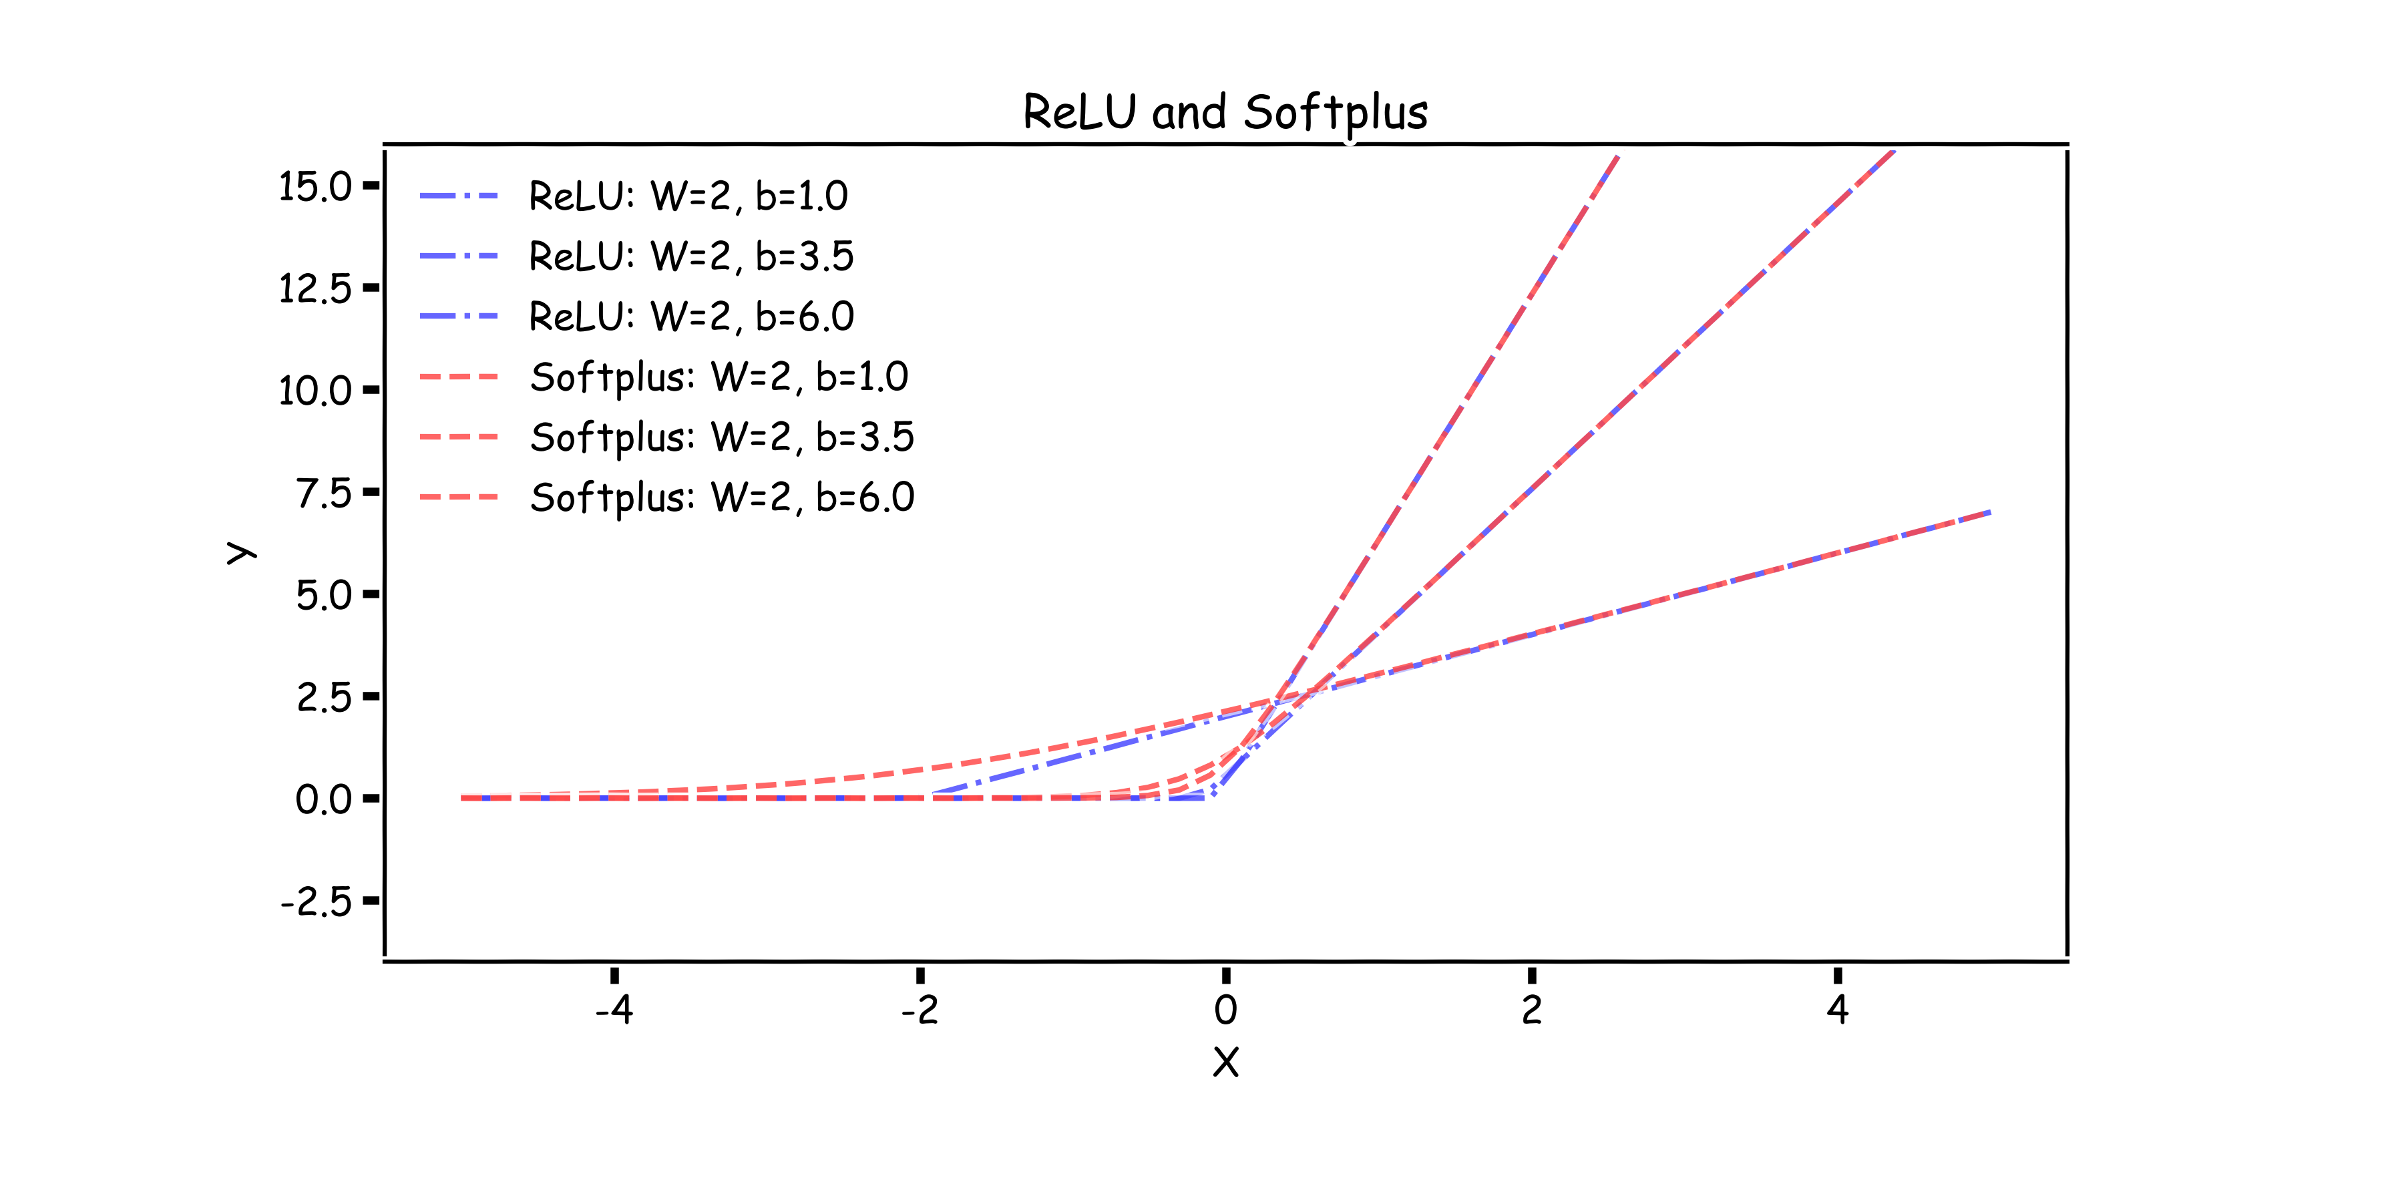
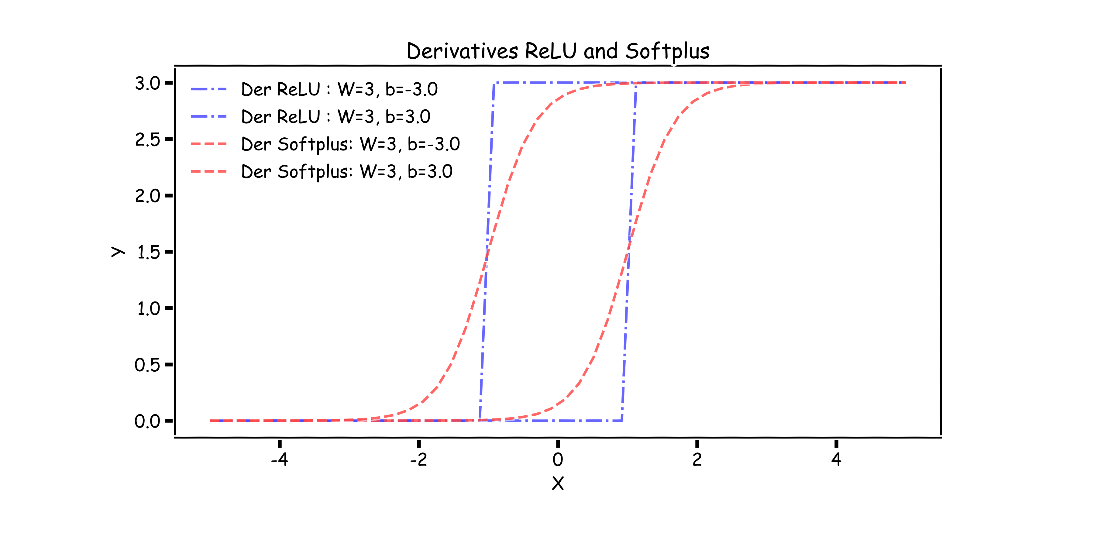
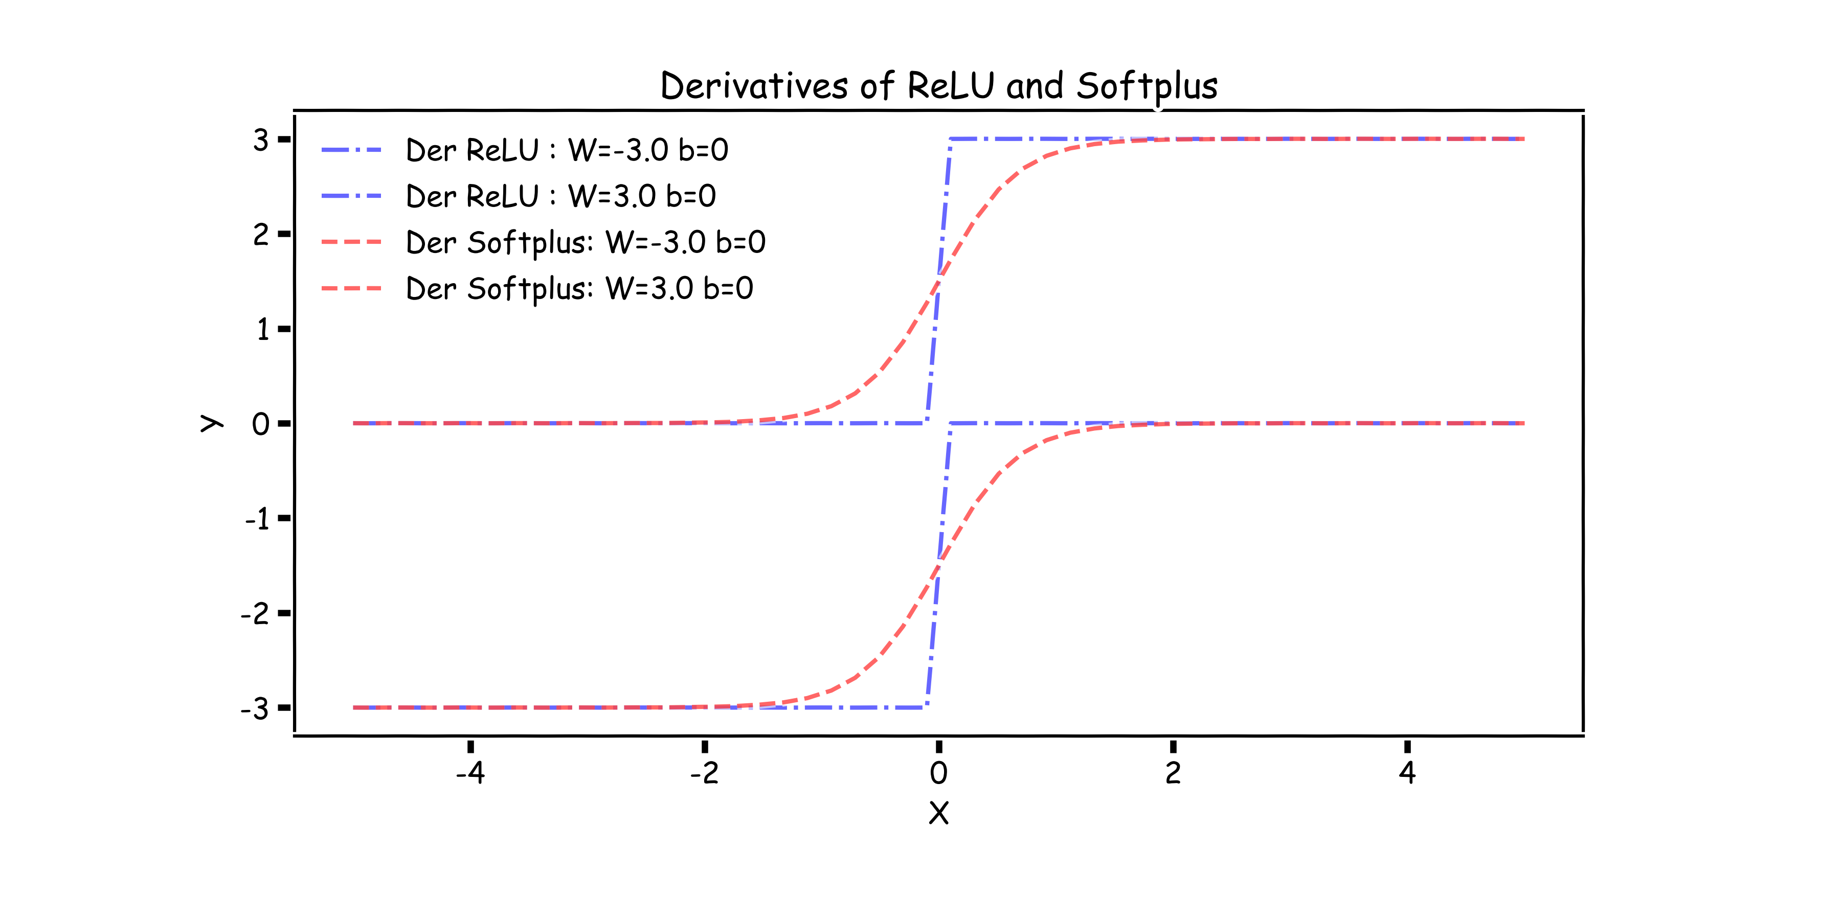
Relu and Softplus
-b/W

Slide 26
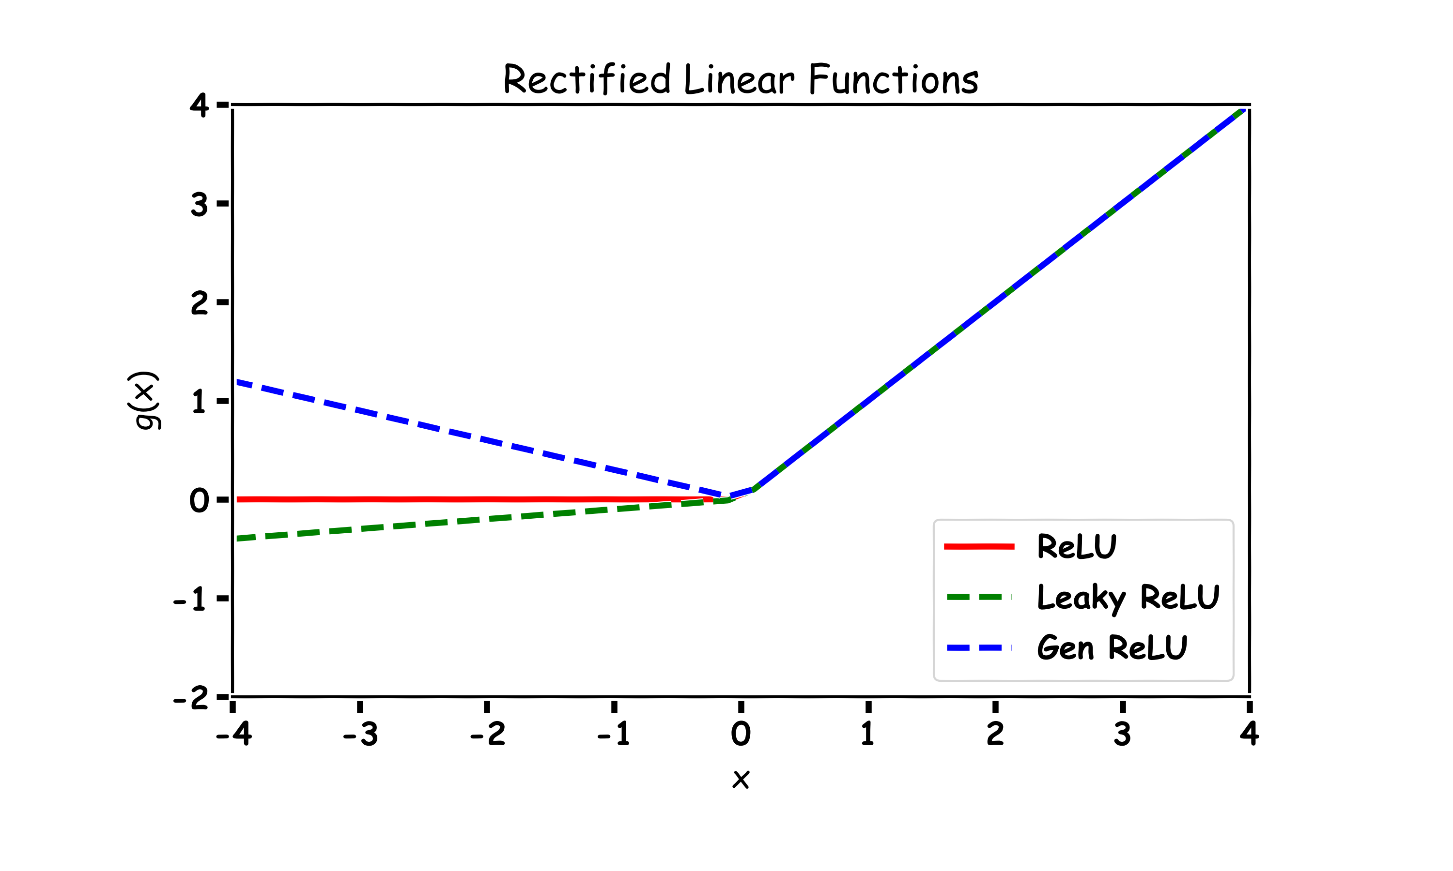

Generalized ReLU
Generalization: For $α_{i}>0$
$$g\left(x_{i}, α\right)=\max\left\{a,x_{i}\right\}+α\min{\{0,x_{i}\}}$$
E.g. Absolute value ReLU:

Slide 27


Maxout
Max of k linear functions. Directly learn the activation function.
$$g(x)= \max_{i∈\{1,…,k\}}{α_{i}x_{i}+β}$$

Slide 28
Outline
Anatomy of a NN
Design choices
Activation function
Loss function
Output units
Architecture

Slide 29

Loss Function
Cross-entropy between training data and model distribution (i.e. negative log-likelihood)
$J\left(W\right)=−𝔼_{x,y\sim {\hat{p}}_{data}}\log{p_{model}}$(y|x)
Do not need to design separate loss functions.
Gradient of cost function must be large enough

Slide 30



Loss Function
Example: sigmoid output + squared loss
$$L_{sq}={\left(y−\hat{y}\right)}^{2}={\left(y−σ\left(x\right)\right)}^{2}$$
Flat surfaces

Slide 31



Cost Function
Saturates only when the model makes correct predictions
Example: sigmoid output + cross-entropy loss
$$L_{ce}\left(y,\hat{y}\right)=−\{ y\log{\hat{y}+\left(1−y\right)\log{(1−\hat{y})\}}}$$

Slide 32
Design Choices
Activation function
Loss function
Output units
Architecture
Optimizer

Slide 33
Output Units
Output Type | Output Distribution | Output layer | Cost Function
Binary

Slide 34



Link function
$$X⟹φ\left(X\right)=W^{T}X⟹P\left(y=0\right)=\frac{1}{1+e^{φ(X)}}$$
X
Y
OUTPUT UNIT
X
$$φ\left(X\right)$$
$$σ(φ)$$
Y

Slide 35
Output Units
Output Type | Output Distribution | Output layer | Cost Function
Binary | Bernoulli | Sigmoid | Binary Cross Entropy

Slide 36
Output Units
Output Type | Output Distribution | Output layer | Cost Function
Binary | Bernoulli | Sigmoid | Binary Cross Entropy
Discrete

Slide 37



Link function multi-class problem
X
Y
OUTPUT UNIT
$$Y=\frac{e^{φ_{k}\left(X\right)}}{\sum_{k=1}^{K}{e^{φ_{k}\left(X\right)}}}$$
X
$$\vec{φ}(X)$$
$$SoftMax$$

Slide 38
Output Units
Output Type | Output Distribution | Output layer | Cost Function
Binary | Bernoulli | Sigmoid | Binary Cross Entropy
Discrete | Multinoulli | Softmax | Cross Entropy

Slide 39
Output Units
Output Type | Output Distribution | Output layer | Cost Function
Binary | Bernoulli | Sigmoid | Binary Cross Entropy
Discrete | Multinoulli | Softmax | Cross Entropy
Continuous | Gaussian | Linear | MSE

Slide 40
Output Units
Output Type | Output Distribution | Output layer | Cost Function
Binary | Bernoulli | Sigmoid | Binary Cross Entropy
Discrete | Multinoulli | Softmax | Cross Entropy
Continuous | Gaussian | Linear | MSE
Continuous | Arbitrary | - | GANS

Slide 41
Design Choices
Activation function
Loss function
Output units
Architecture
Optimizer

Slide 42


NN in action

Slide 43


NN in action

Slide 44


NN in action

Slide 45

NN in action
…

Slide 46


NN in action

Slide 47


NN in action

Slide 48


NN in action

Slide 49






Universal Approximation Theorem
Think of Neural Network as function approximation.
$$Y=f\left(x\right)+ε$$
$$Y=\hat{f}(x)+ε$$
NN: $⟹\hat{f}(x)$
One hidden layer is enough to represent an approximation of any function to an arbitrary degree of accuracy
So why deeper?
Shallow net may need (exponentially) more width
Shallow net may overfit more
$$W_{3}$$
$$\hat{Y}$$
$$W_{2}$$
$$W_{4}$$
depth
$$W_{1}$$
width

Slide 50

Better Generalization with Depth
(Goodfellow 2017)

Slide 51

Large, Shallow Nets Overfit More
(Goodfellow 2017)

